Slide 1
Weekly report
Doan Manh Hung

Slide 2
Last Week
- Finish Analysis of thin-walled closed beam with general quadrilateral cross section.

Slide 3
This week
L=750 mm
a=75 mm
b=25 mm
h=25 mm
t=3.18 mm
E=200 kN/mm2
v=0.3
F
a
F
y
x
h
b

Slide 4
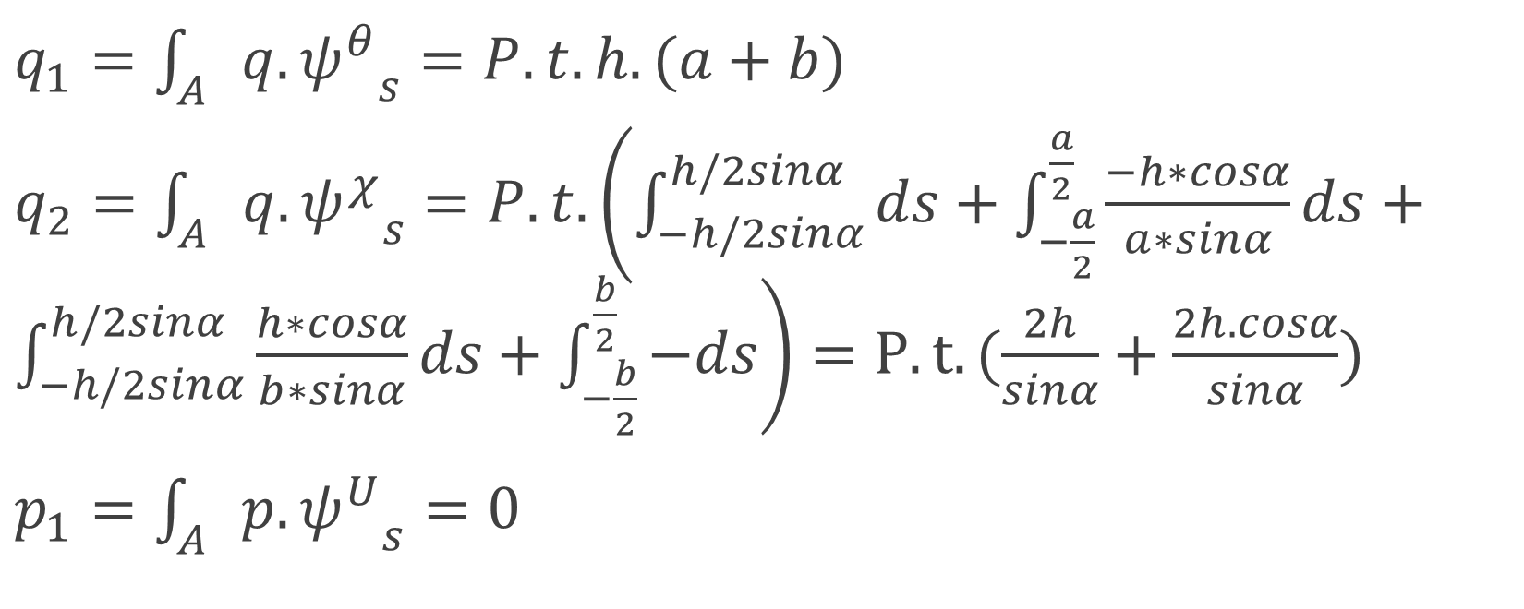
External load in tangential and axial directions
$q_{1}=\int_{A}{q. {ψ^{θ}}_{s}}=P.t.h.(a+b)$
$q_{2}=\int_{A}{q. {ψ^{χ}}_{s}}=P.t.\left(\int_{−h/2sinα}^{h/2sinα}{ds}+\int_{−\frac{a}{2}}^{\frac{a}{2}}{\frac{−h∗cosα}{a∗sinα}ds}+\int_{−h/2sinα}^{h/2sinα}{\frac{h∗cosα}{b∗sinα}ds}+\int_{−\frac{b}{2}}^{\frac{b}{2}}{−ds}\right)=P.t.(\frac{2h}{sinα}+\frac{2h.cosα}{sinα})$
$p_{1}=\int_{A}{p. {ψ^{U}}_{s}}=0$

Slide 5
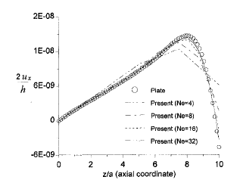
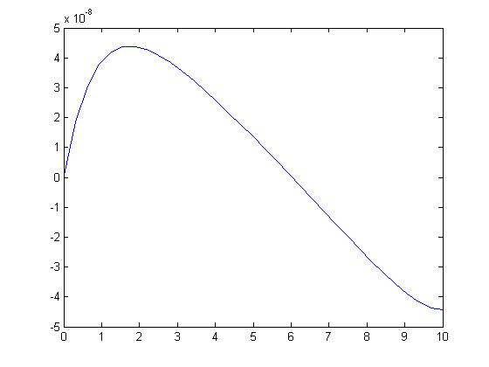
Results

Slide 6
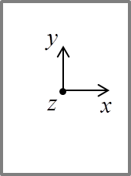
Next week
-1D cases in rectangular cross section of thin walled beam.
Shear force(bending): 2 dof (rigid motion)
Shear force(bending): 3 dof
F_{x}

